Slide 1
Interfaces
Rajasekaran S
Assistant Professor,
Department of Information Technology,
KGiSL Institute of Technology,
email: proffraja@gmail.com
Github:www.github.com/rajasekaranap

Slide 2
Interfaces
It is collection of abstract methods.
It is similar to classes.
Classes implements the interfaces.
It is also contains constants, default methods and static methods.
If a class implements an interface then it must implement all the abstract methods of interface otherwise the class consider as abstract class.

Slide 3
Interface Syntax
access-modifier interface interface-name{
access-modifier final data-type var-1;
access-modifier final data-type var-2;
...
access-modifier method -1(args);
access-modifier method -2(args);
...
access-modifier static method -1(args){
//block of code
}
...
default method -1(args){
//block of code
}
...
}
Abstract Methods

Slide 4
Interface Syntax
public interface VehicleOperations{
public void start();
public void stop();
}
Abstract Methods

Slide 5
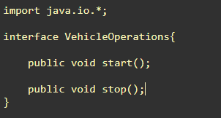
Interface Created

Slide 6
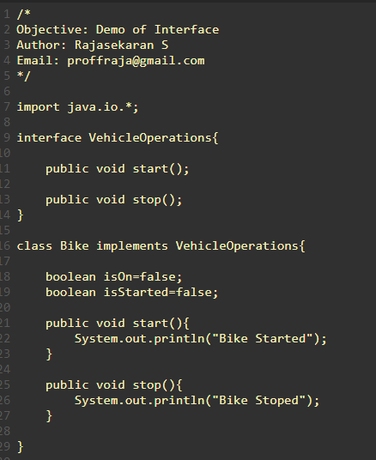
Implementing Interface
http://cyberdojo1.kgfsl.com/review/show/cTYDjZ9w4h?avatar=jellyfish&was_tag=1&now_tag=2&filename=undefined
Interface
Keyword
Interface Implemented

Slide 7
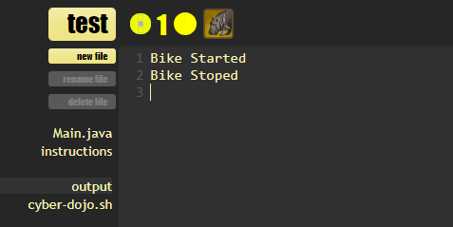
Output

Slide 8
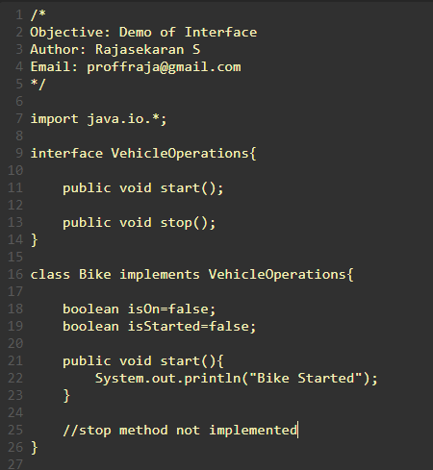
Need to Implement All the Interface
Interface
Interface Implemented
http://cyberdojo1.kgfsl.com/review/show/z0gjMMSusd?avatar=hippo&was_tag=1&now_tag=2&filename=Main.java

Slide 9
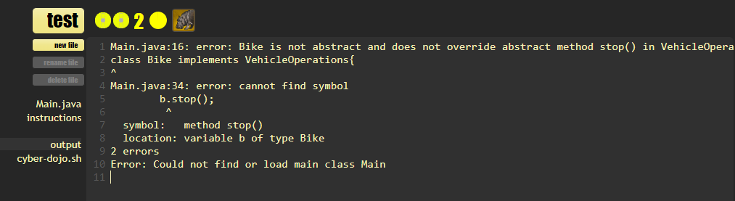
Output
Class must implement all the interfaces with out fail.

Slide 10
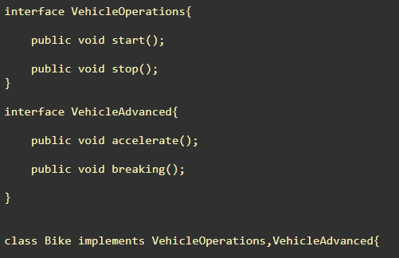
Multiple Interfaces
Interface 1
Interface 2
Implementation
http://cyberdojo1.kgfsl.com/review/show/z0gjMMSusd?avatar=hippo&was_tag=6&now_tag=7&filename=undefined

Slide 11
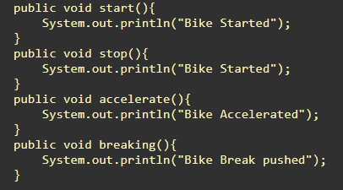
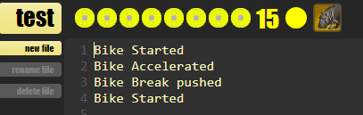
Output
Implementation
Output

Slide 12
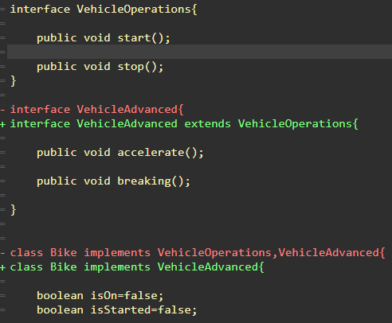
Interfaces can be extended
Interface 1
Extended Interface
Class Implementing Extended Interface

Slide 13
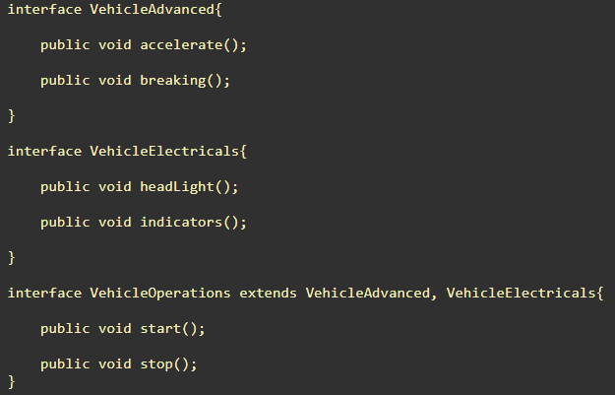
Interface can extend more than one Interface
Interface 1
Interface 2
Multiple Inheritance

Slide 14
Class vs Interface
Class | Interface
It doesn't supports multiple inheritance | It supports multiple inheritance
Key word “extends” used | Key word “implements” used
Should contain only concrete [Implemented] methods. | Should contain only abstract [Non Implemented] methods.
The methods can have any access spacifier. | The methods must be declared as public.
It can contain instance variables. | It must contain final static variable.
Variables can be private | Variables must be public
Can have constructors | Cannot have constructors
Can have main method | Main is a concrete method so we can’t have in interface

Slide 15
Interface vs Abstract Class
Interface | Abstract Class
Interface supports multiple inheritance | Abstract class doesn’t supports multiple Inheritance
It doesn't contain data members [instance variables] | It can contain data variable
It doesn't contain constructor | It can contain constructor
It contain only abstract methods | It contain abstract methods as well as concrete methods.
All access specifiers assumed as public | Can have any access specifiers

Slide 16
Thank You
Rajasekaran S
Assistant Professor,
Department of Information Technology,
KGiSL Institute of Technology,
email: proffraja@gmail.com
Github:www.github.com/rajasekaranap

